Slide 1







An Update on Deep-Earth Life at the NNSS
Duane P. Moser
Desert Research Institute
07/26/2011
2011 CEMP Workshop
Brian Head, UT

Slide 2
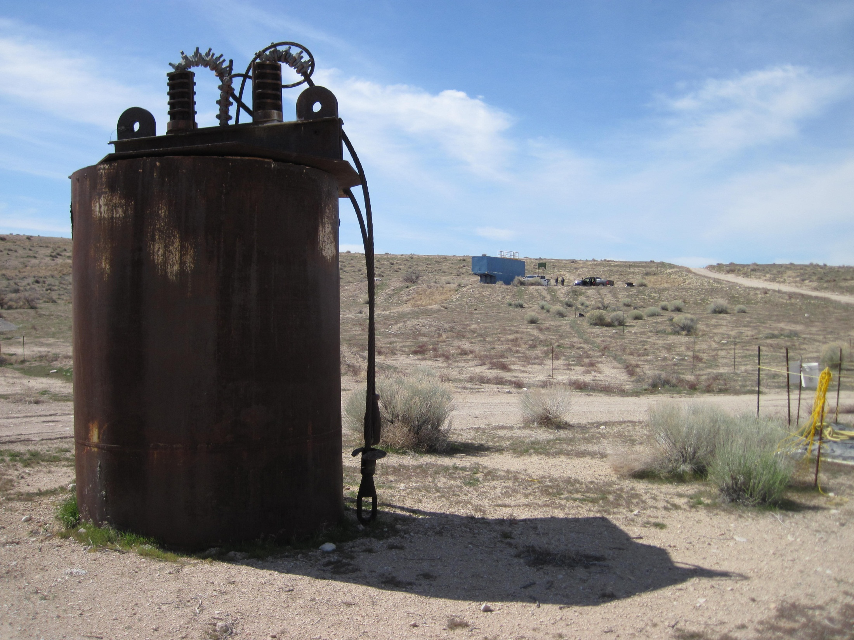
Technical Contributors
DRI: Jim Bruckner, Jen Fisher, Jessica Newburn, Chuck Russell, Ron Hershey
LLNL: Mavrik Zavarin, Annie Kersting, Rachel Lindval, Sarah Roberts
Princeton: TC Onstott
UNLV: Ken Czerwinski
University of Toronto: Barb Sherwood Lollar
Indiana University: Lisa Pratt
LBNL: Mark Conrad, Eoin Brodie, Todd DeSantis
University of OK: Jizhong Zhou
Bigelow Laboratory: Ramunas Stepanauskas
NNSA-cleared photo

Slide 3
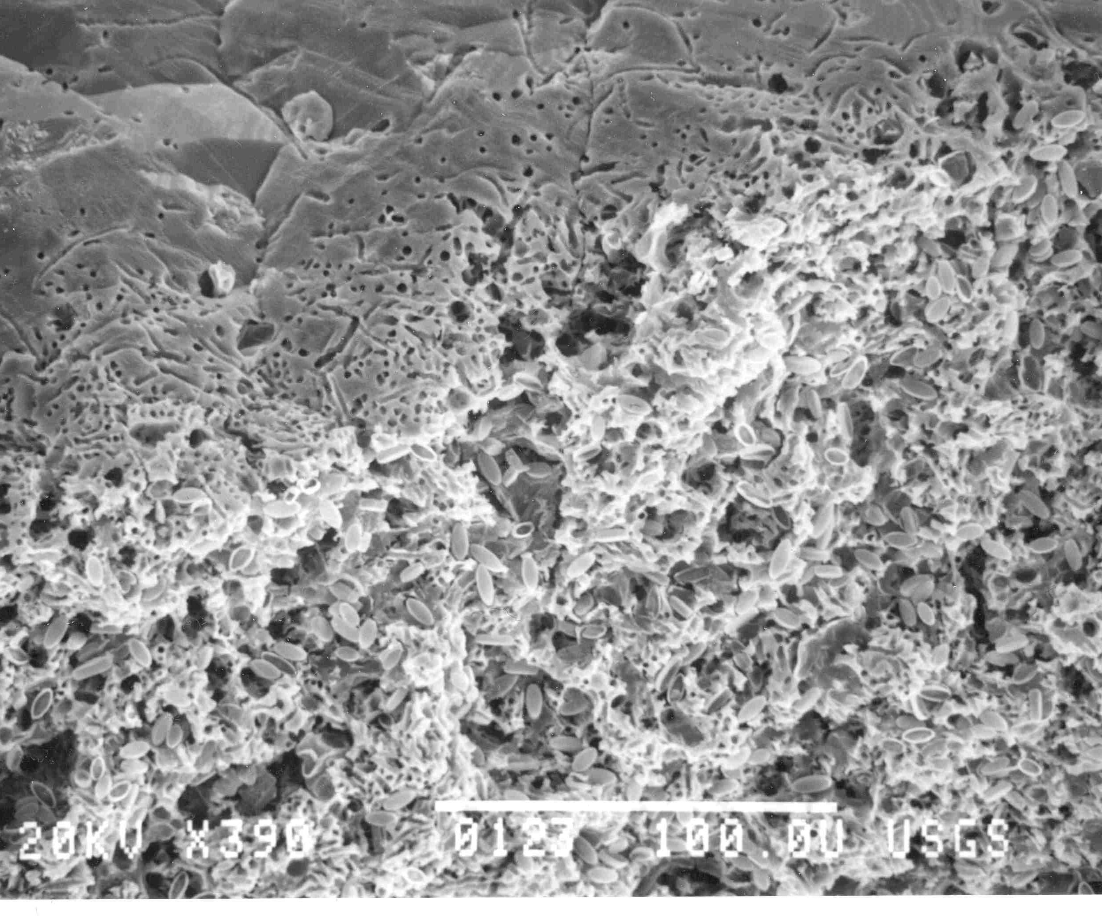
Deep Life: important?
Exploration: Earth’s last new (?) biome
Exobiology: model for life off the Earth
Extremophiles: origins and limits of life
Elemental cycles (e.g. C)
Radionuclide mobility? (NNSS)
Devils Hole rock-boring bacteria, Alan Riggs, USGS

Slide 4
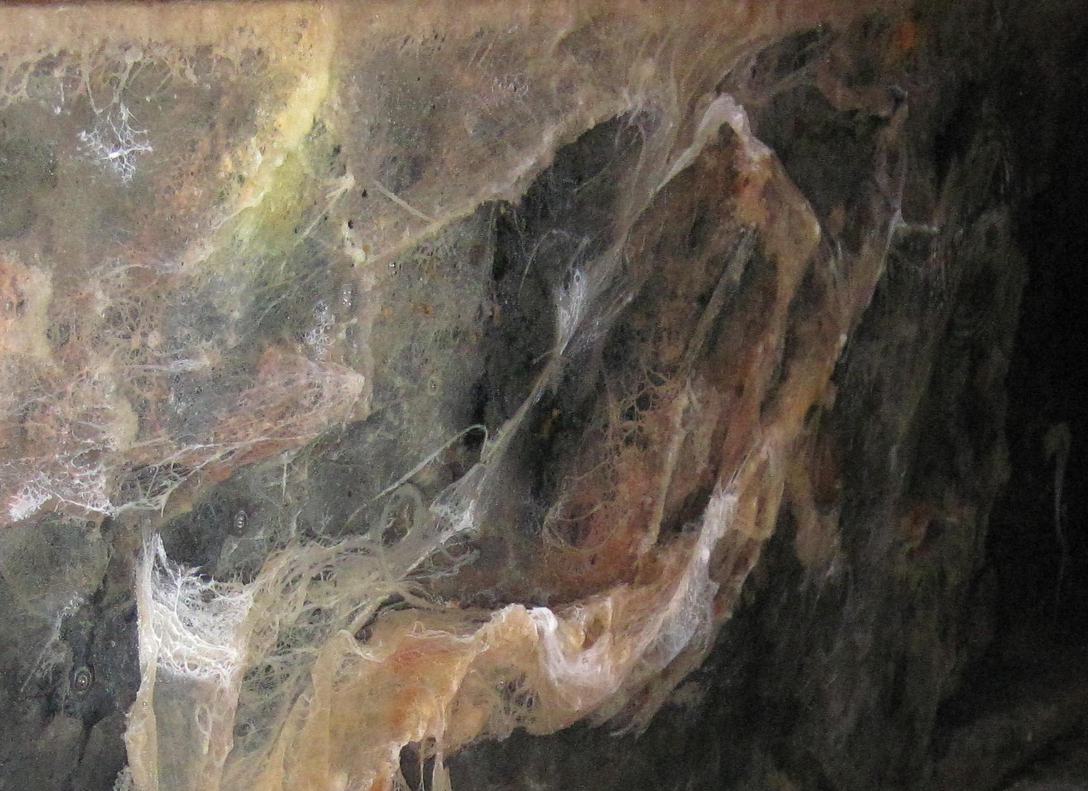
Deep Biosphere Research: Challenges
Deep Biosphere Research: Persistent Challenges
Getting samples in the first place
Microbial and chemical contamination
Introduction of oxygen
From Michael King, Devils Hole workshop, 2007

Slide 5
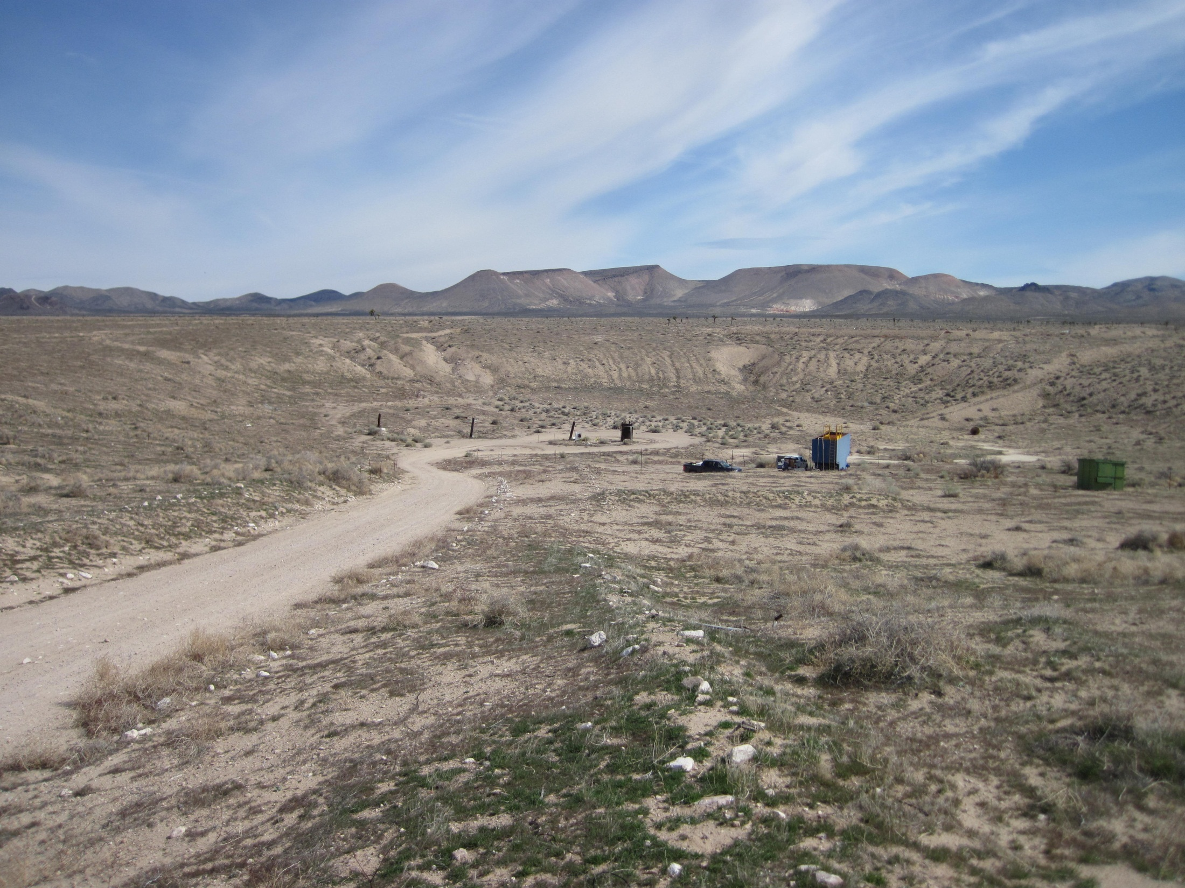
Our Projects in NNSS Area
LLNL: sorption/desorption of actinides
Sampling
  UGTA (wells)
  Navarro Interra (wells)
  Nye County NWRPO (wells)
  The Hydrodynamics Group (wells)
  Ash Meadows (springs)
  Devils Hole
NNSA-cleared photo

Slide 6
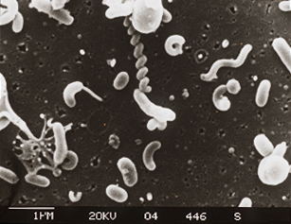
Methods:
The Great Plate Count Anomaly
Image from Steve Giovannoni

Slide 7
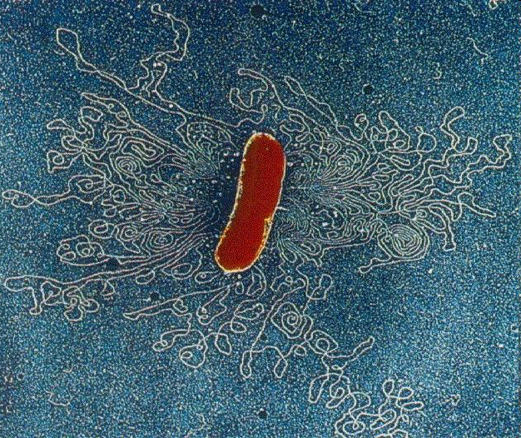
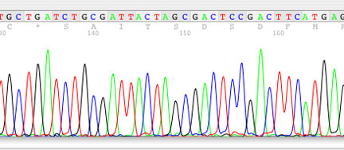
Molecular Ecology

Slide 8
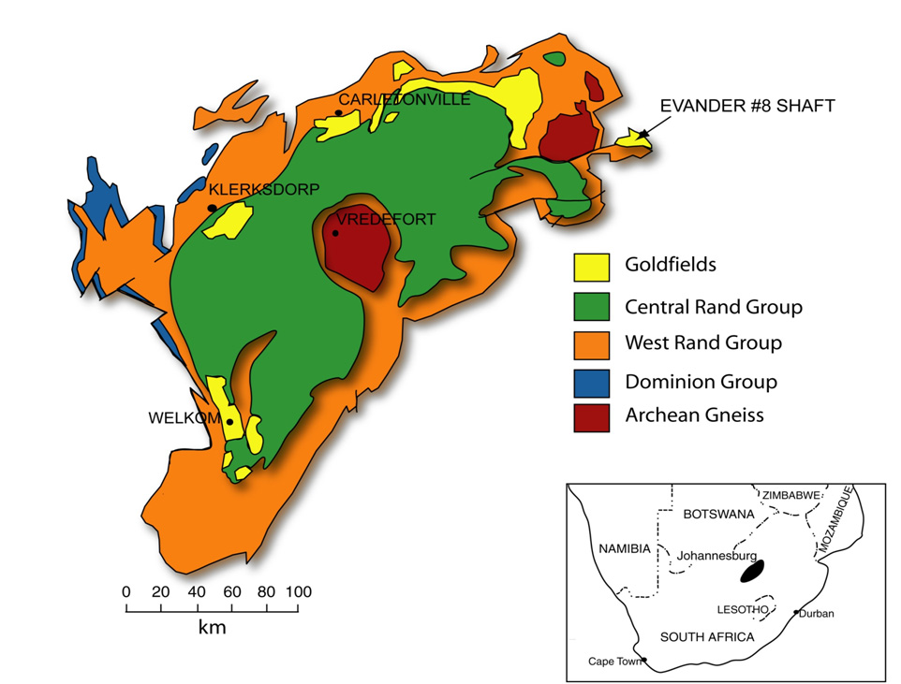
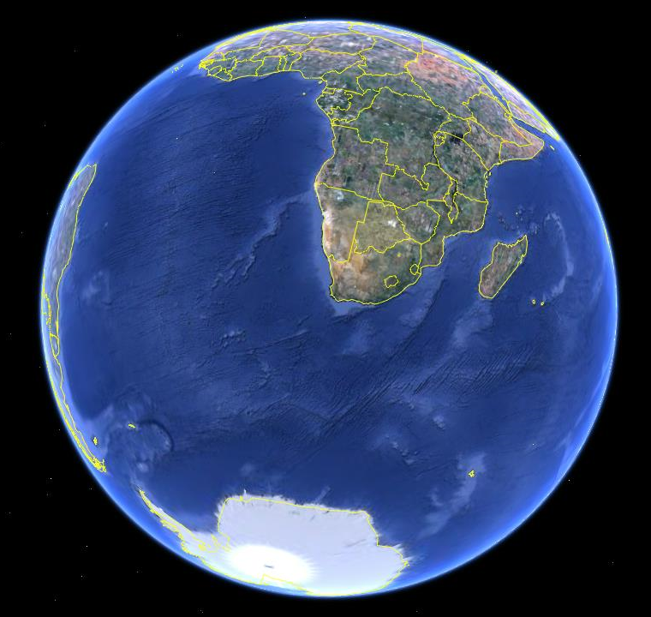

Slide 9
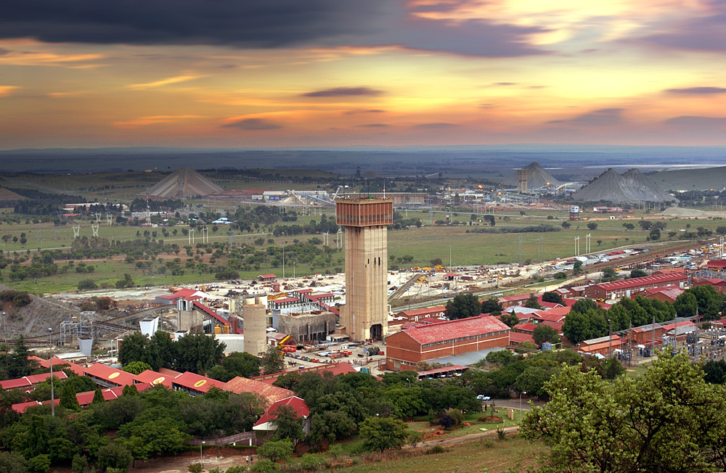
Tau Tona Mine, South Africa

Slide 10
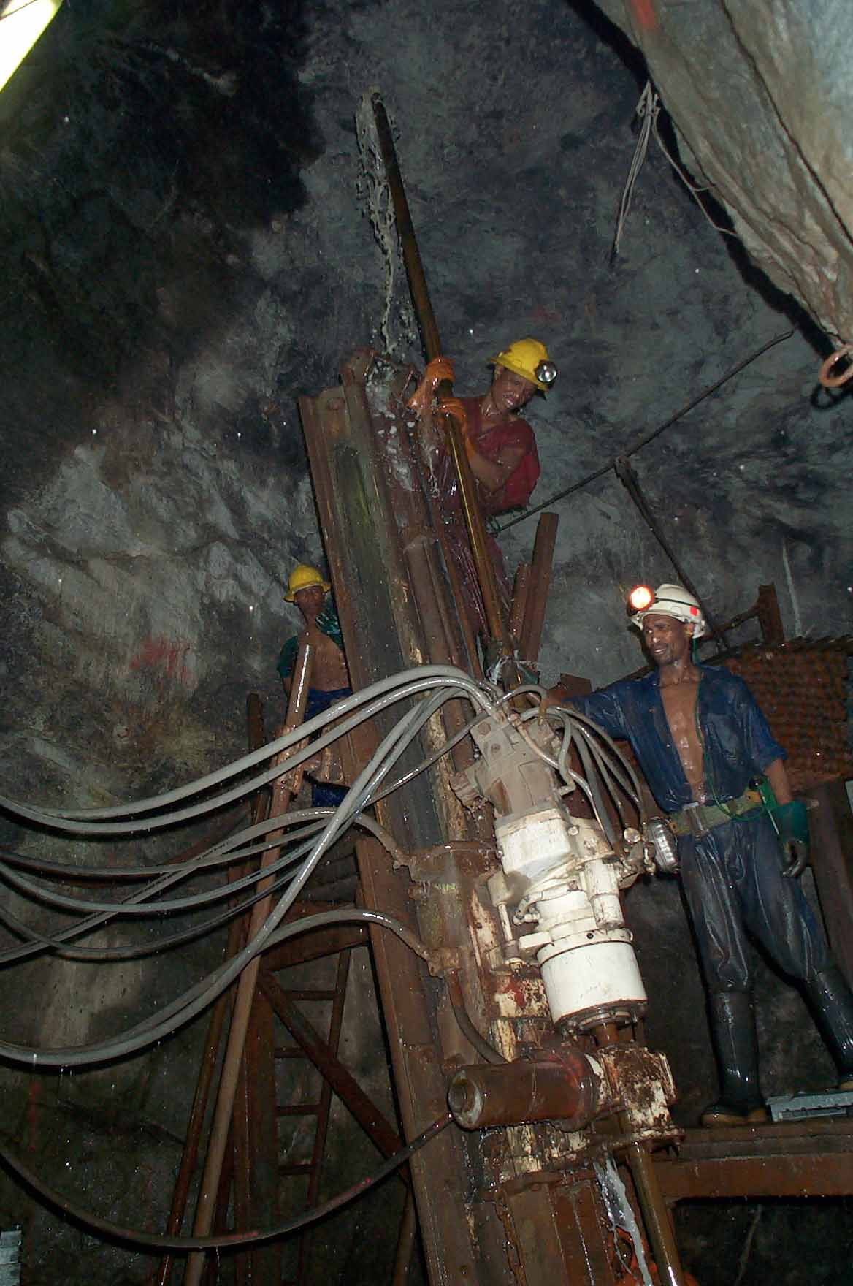
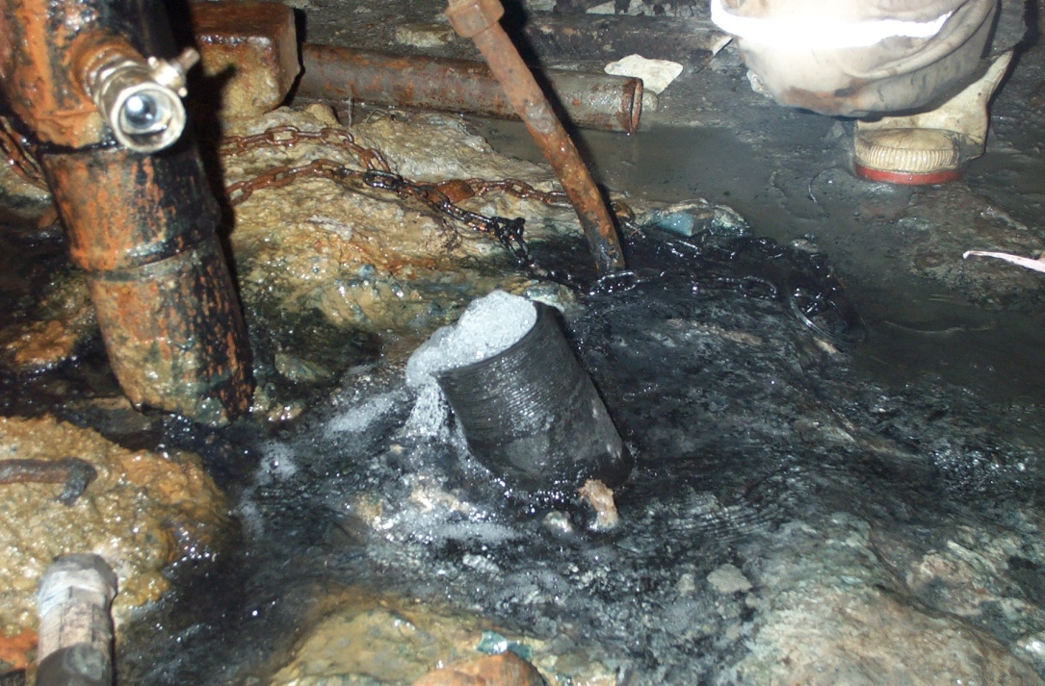
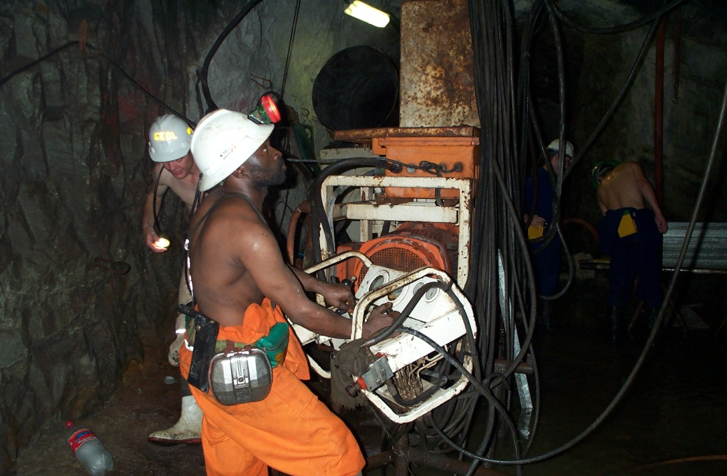
Deep Drilling in Mines
Evander Mine 8 Shaft 18 Level, 2.1 kmbls

Slide 11
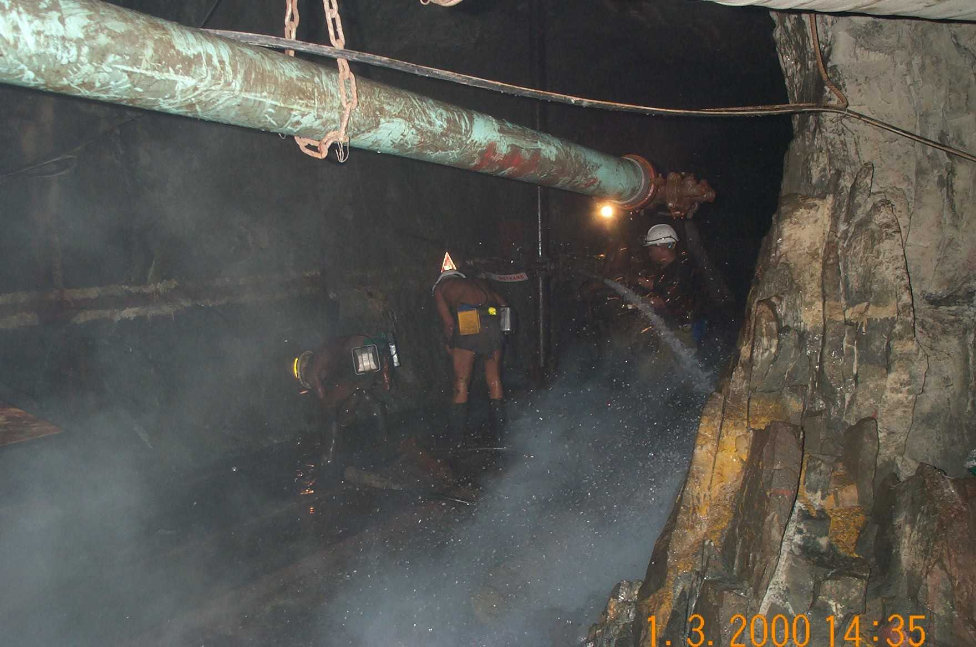
Kloof Mine , 3.3 kmbls, Photo by Arnand vanHeerden

Slide 12
Desulforudis audaxviator
“Based on its rod-like morphology, its apparent use of the dissimilatory sulfate reduction pathway for energy production, and because of the journey this "audax viator" (bold traveler) undertook to live in the extreme depths of the Earth, we have named this organism Candidatus Desulforudis audaxviator".
From Chivian, D., et al. In preparation…
Chivian, D., E.J. Alm, E.L. Brodie, et al., Science, 2008.

Slide 13
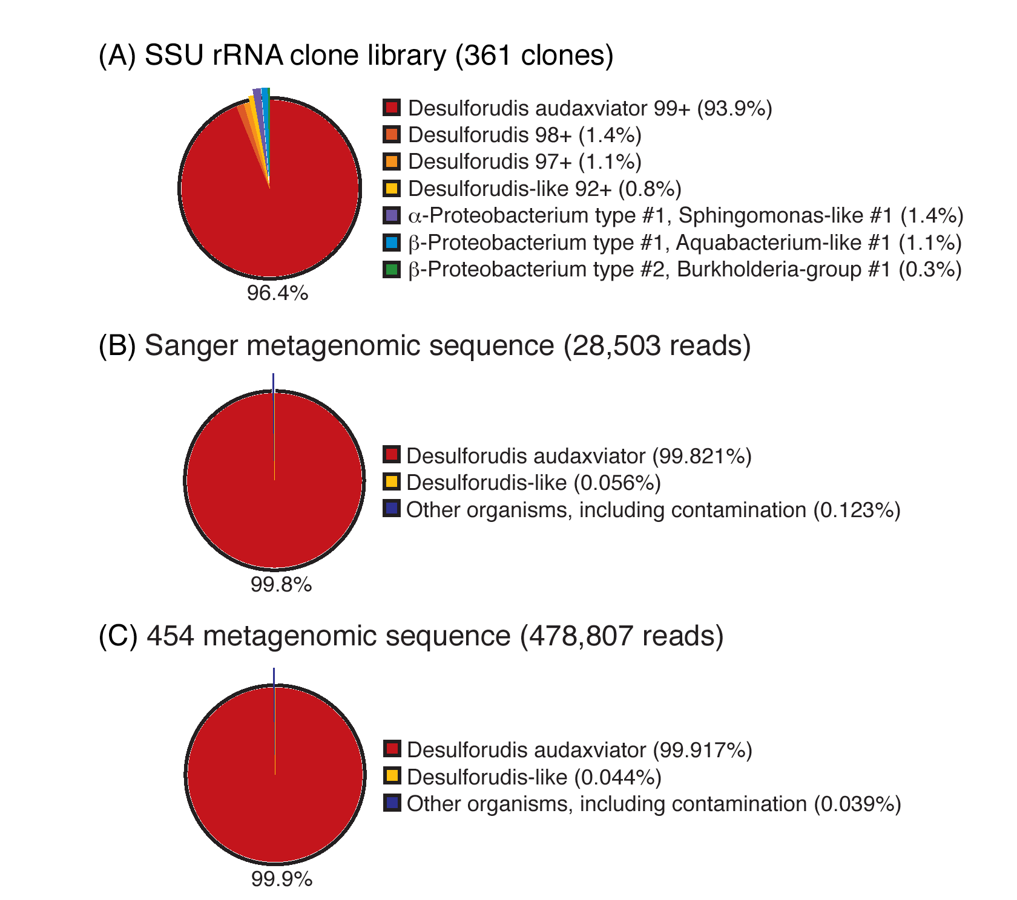
Population assessments of MP104E46X
Chivian, D., E.J. Alm, E.L. Brodie, Science, 2008.

Slide 14
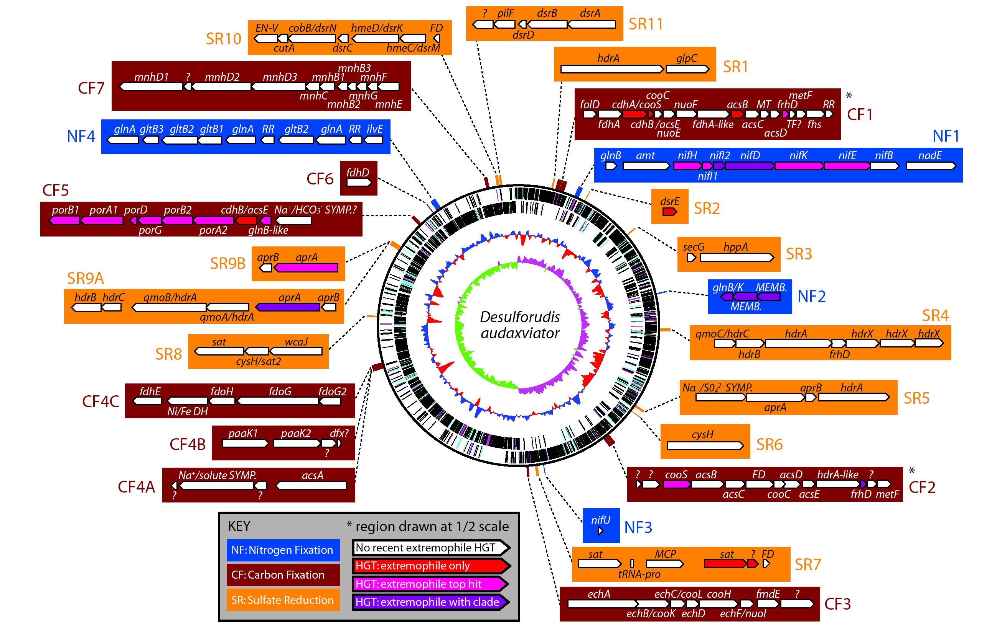
Chivian, D., E.J. Alm, E.L. Brodie, Science, 2008.

Slide 15
Chivian, D., E.J. Alm, E.L. Brodie, Science, 2008.

Slide 16
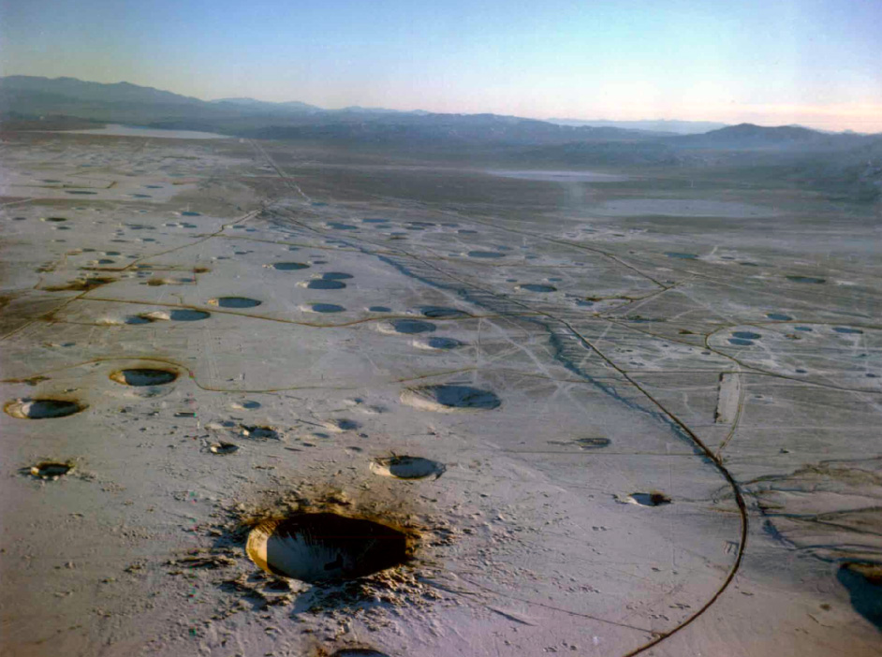
Nevada National Security Site (NNSS)
NNSS USA Photo Library

Slide 17
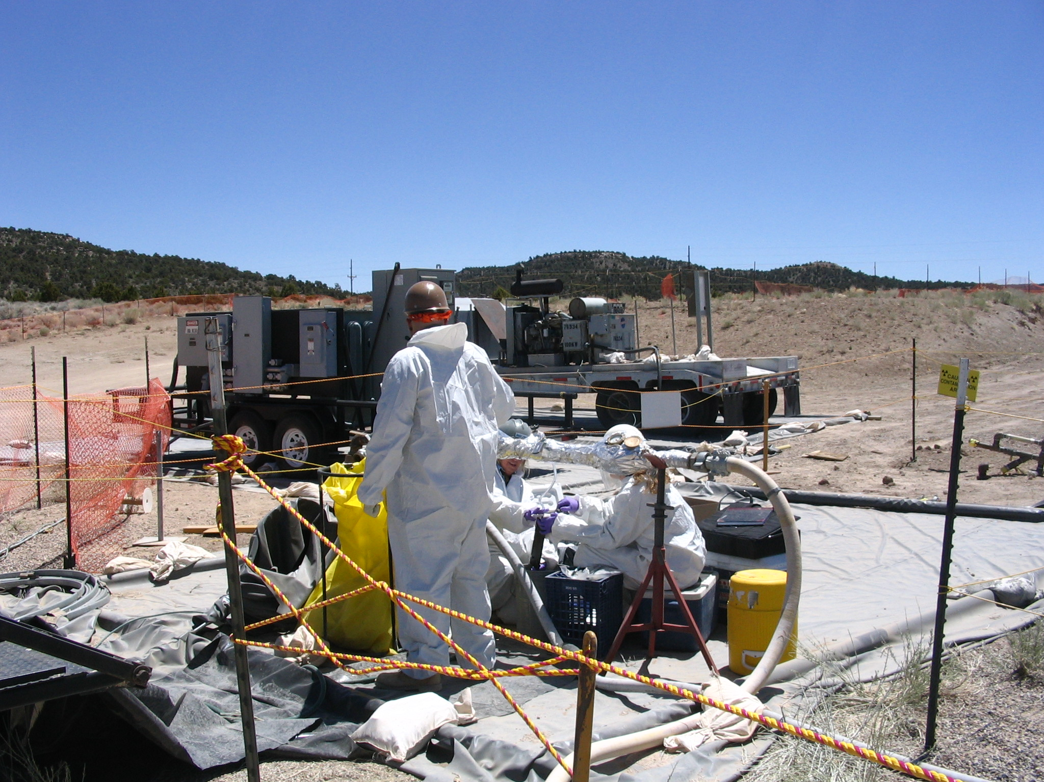
Tale of Two Wells
NNSS Hot Wells
BLM 1
Nevares Deep Well 2
NNSA-cleared photo

Slide 18
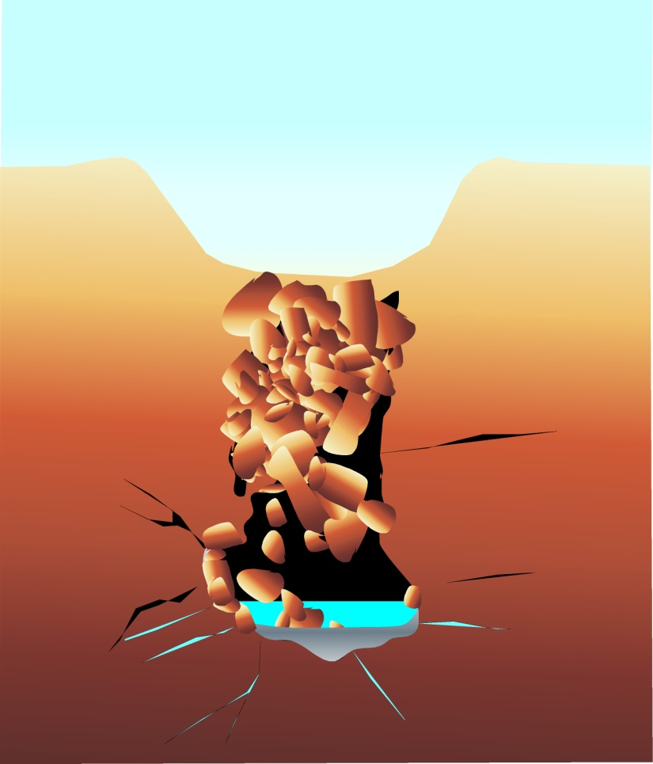

Farfield well
Cavity well
Nearfield well
Detonation Point
Cavity
Groundwater
Melt glass
Cleared figure, NNSA
Cavity well
Nearfield well
Detonation Point
Cavity
Groundwater
Melt glass

Slide 19
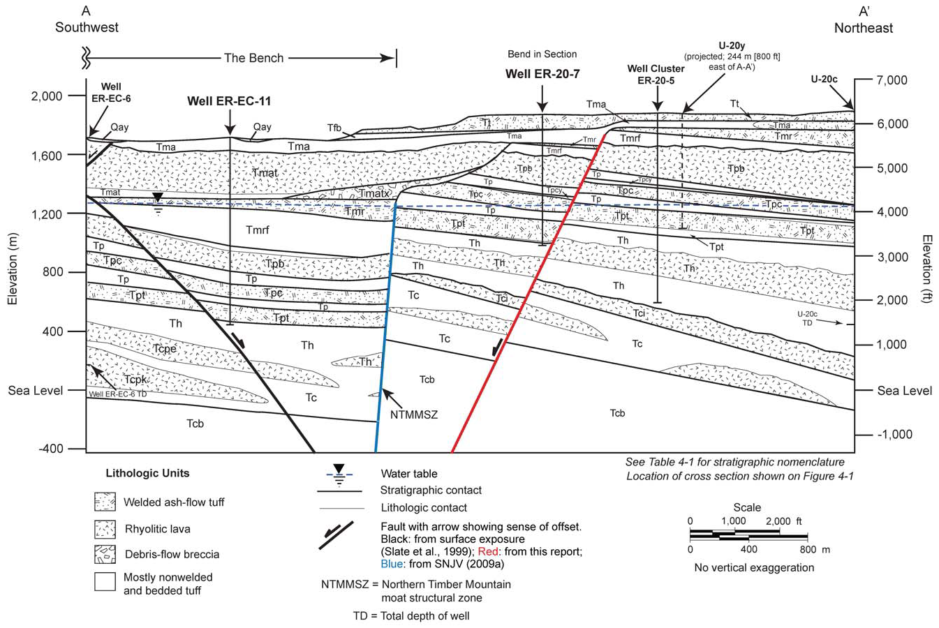
Cross section showing geological environment intersected by new project wells, ER-EC-11 and ER-20-7. Both are considered hot wells, although ER-EC-11 contains only tritium at below the drinking water standard. Lettering refers to specific geological units (e.g. Tcb = Bullfrog Tuff, Tpt = Topopah Spring Tuff).
Reproduced from U.S. Department of Energy. 2010. Completion Report for Well ER-20-7 Corrective Action Units 101 and 102: Central and Western Pahute Mesa. DOE/NV—1386, April 2010.

Slide 20
100
Unc mbI-b57 (anaerobic benzene-degrading methanotrophic consortia)
100
GASCON 02A [2]
78
Olavius algarvensis sulfate-reducing endosymbiont
Desulfobacterium anilini AK1 (sulfate reducer, phenol degradation & carboxylation)
57
100
U12N.10B 05A
87
Syntrophus aciditrophicus SB
U12N.10V 01E [3]
Delta
83
98
Unc mbI-b16 (anaerobic benzane-degrading methanotropic consortia)
100
GASCON 06G [4]
Pelobacter venetianus (dissimilatory Fe(III)-reducer)
84
100
U12N.10V 07E
100
Unc BTEX2-9F (hydrocarbon-degrading consortia, oil sands tailings)
75
GASCON 08F
Desulfovibrio sp. zt31 (sulfate-reducer)
100
GASCON 03G [7]
69
U12N.10B 01F
HS-4850B-04G (5)
100
Unc MS149BH1062003317 (subsurface water, Kalahari Shield, SA)
38
U12N.10V 03C [2]
38
U12N.10V 09A [2]
38
GASCON 02G [2]
AY741704 Unc. clone TTMF164 (SA gold mine)
75
GASCON 01F [4]
16
Unc JH-WH250 (Fe-Mn nodule community)
38
GASCON 04A
NSDW2 09C
38
96
Unc PYR10d2 (pyrine degrading community)
3
Sterolibacterium denitrificans Chol-1S
NASH 07C
NASH 05B
NSDW2 04E (3)
59
Azonexus fungiphilus
3
NASH 03G
23
Garrityella koreensis 5YN10-9
6
NASH 05H
NSDW2 12E
3
90
NASH 09D [2]
2
Unc SJA-109 (anaerobic trichlorobenzene-transforming consortium)
57
Rhodocyclus tenuis
HS-4850B-09D
63
NASH 03D [7]
99
Azospira oryzae N1 (selenate/selenite reducer)
2
NASH 08F [2]
58
NASH 07F
NSDW2 05G
73
Unc 015B-E09 (nitric acid-bearing uranium waste groundwater community)
92
GASCON 04D [3]
15
53
Siderooxidans ghiorsii LD-1 (neutraphilic Fe(II)-oxidizer)
Beta
NSDW2 11B (3)
Thiobacter subterraneus (obligate hemolithoautotrophic, thermophilic, S-oxidizer, subsurface hot aquifer)
36
NASH 03E [9]
Thiobacillus sajanensis 4HG (autotrophic sulfide-oxidizer)
79
U12N.10V 01A [7]
NSDW2 12F
5
100
U12N.10B 05C
24
Unc cMM319-36 (magnesite mine, Austria)
100
NASH 04F
BLM-1 01G (7)
36
Aquabacterium sp. GPTSA100-18
32
100
U12N.10B 03B
100
61
Delftia sp. XYJ6
Comamonas testosteroni
AB232785 Pelotomaculum isophthalicicum
99
U12N.10V 04G [2]
88
Hydrogenophaga sp. AH-24
88
U12N.10V 08E
ALMENDRO 09H
99
99
Unc CVCloAm2Ph104 (alkaline env, Portugal)
92
GASCON 06B
Herbaspirillum seropedicae
78
NASH 04A [2]
AY884087 Moorella thermoacetica
95
NASH 05E [3]
100
Ralstonia sp. 22 (arsenite oxidizer)
100
61
NASH 07G
Methylobacillus flagellatus KT
BLM-1 02E
53
Unc SLB74 (late holocene lake sediment)
90
77
NASH 04B [2]
54
NASH 11F [15]
ALEMAN 03A
NASH 06G
100
Unc IFD_12 (Mt. Nan-Jen soil)
Gamma
U12N.10V 03B [3]
52
100
Thiovirga sulfuroxydans (microaerophilic chemolithoautotrophic sulfur-oxidizer)
U12N.10B 03A
96
U12N.10V 05H
100
NASH 10C
Anaplasma phagocytophilum
GASCON 01B (5)
Porphyrobacter tepidarius OK5APO
96
NASH 03A [7]
71
41
Phenylobacterium falsum AC-49T (alkaline groundwater)
69
NASH 05A
AB436739 Desulfonosporus sp. AAN04
11
59
GASCON 12E
81
Phenylobacterium lituiforme (thermophile, subsurface aquifer)
99
100
NASH 03C [2]
NASH 10G
79
Caulobacter sp. A1
Caulobacter sp. FWC38
73
NASH 01A [12]
Alpha
91
Alpha proteobacterium OS-12B (Pb-Zn mine tailing site)
U12N.10B 03H
48
38
100
GASCON 05E
Parvibaculum lavamentivorans DS-1
100
U12N.10V 05D
BLM-1 11A
99
Unc EV818CFSSAHH3 (subsurface water, Kalahari Shield, SA)
26
98
U12N.10B 03C
100
Unc F01-2 (gold mine biofilm)
Hyphomicrobium sp. WG6 (methyl-chloride utilizer)
BLM-1 01F
86
84
U12N.10B 01E
Rhodoplanes sp. DAS (purple non-sulfur bacteria)
100
GASCON 02D
95
Unc YK_31 (oil contaminated soil)
Y11574 Desulfotomaculum thermobenzoicum
54
NASH 08G
100
Bradyrhizobium japonicum CCBAU 05185
Ilyobacter tartaricus (fermentative hydroaromatic-compound degrader)
Fusobacteria
BLM-1 07A
100
U12N.10V 11G
15
62
Unc from oxidized iron deposits
100
GASCON 01G [10]
Spirochaetes
100
Spirochaetes bacterium SA-10 (gold mine)
U12N.10V 09D (2)
36
Spirochaeta taiwanensis K1LY
34
NASH 06F
100
Unc 54 (SBR community)
U12N.10B 04B (5)
Chlorobium phaeobacteroides DSM 266
Chlorobi
95
U12N.10V 07D
100
Unc zEL36 (cave biofilm associated w/ limestone corroding stream)
100
U12N.10V 11F [2]
AY604055 Unc. clone DR9IPCB16SCT8 (SA gold mine)
44
100
Unc HDBW-WB41 (fault-bordered aquifers, Japan)
7
65
U12N.10V 08H
U12N.10V 05G
FJ712408 Unc KZNMV-0-B13 (Kazan Mud Volcano)
100
Unc HB21 (activated sludge)
Bacteroidetes
100
100
U12N.10V 08D
Unc YWB41 (deep coal seam groundwater, Japan)
48
Cytophaga sp. AN-BI4
U12N.10V 03D
98
Unc Gitt-KF-184 (uranium waste pile community)
100
U12N.10V 06D [2]
52
U12N.10V 01D [2]
AM777970 Unc. clone CVCloAm2Ph32 (alkaline groundwater, Portugal)
82
Unc HDBW-WB39 (fault-bordered aquifers, Japan)
NASH 04G
95
NASH 10A
U12N.10V 06H
Acidobacteria
AY741695 Unc. clone TTMF21 (SA gold mine)
100
Solibacter usitatus Ellin6076 ctg173
100
GASCON 03F [2]
51
GASCON 07H
3
98
GASCON 06A
DQ088771 Unc. clone BE325FW032701CTS_hole1-2 (SA gold mine)
100
Unc BE325FW032701CTS_hole1-77 (fracture-derived groundwater in deep gold mine, SA)
86
GASCON 02C [6]
100
Unc TP89 (Tibetan geothermal region)
NC_010424 Candidatus Desulforudis audaxviator MP104C
Unc. EV818FW062101BH4MD15 (deep terrestrial subsurface fluid-filled fracture)
Actinobacteria
47
100
GASCON 07B [4]
100
U12N.10V 09F
100
U12N.10B 12A
ER-EC-11 07D
Iamibacter majanohamensis
92
Atopobium sp. F0209
100
GASCON 01C [9]
AY753389 Unc. clone SK21 (alkaline district heating system biofilm)
99
Unc Nap1-8C (hydrocarbon-degrading microbial consortia from oil sands tailings)
98
U12N.10V 06F
64
Unc BE325FW032701CTS_hole1-13 (fracture-derived groundwater in deep gold mine, SA)
34
U12N.10V 01B
NC_011296 Thermodesulfovibrio yellowstonii
100
U12N.10B 07A
29
66
U12N.10B 01G
43
Dethiobacter alkaliphilus AHT 1 (haloalkaliphilic bacteria of reductive sulfur cycle from soda lakes)
AJ309733 Aquifex aeolicus
30
U12N.10V 09E
U12N.10V 11D
25
100
U12N.10V 04F
17
10
73
U12N.10V 09C
Anaerobranca gottschalkii
U12N.10B 08A
100
Unc CVCloAm3Ph98 (alkaline environment, Portugal)
59
U12N.10B 03A
Firmicutes
0.02
99
Unc HDBW-WB52 (fault-bordered aquifers, Japan)
17
100
Dehalobacter sp. MS
27
Desulfosporosinus orientis
NASH 10G
100
GASCON 01B [5]
29
54
Unc EtOH8 (metal surface biofilm, alkaline district heating system)
U12N.10B 03H
100
Thermincola carboxydiphila
18
Carboxydocella sp. 1503
Moorella glycerini
52
100
U12N.10V 03D
55
Desulforudis audaxviator MP104C
100
Unc CAMV300B902 (Mud Volcano sediments)
100
U12N.10V 09D [2]
99
U12N.10B 04B [5]
U12N.10V 08F
Thermodesulfovibrio yellowstonii DSM 11347
57
U12N.10V 02B
Nitrospirae
98
99
U12N.10V 01G [2]
75
Unc JG37
38
Unc OPI-2 (Octopus Spring)
48
GASCON 03A [3]
100
U12N.10V 02A [13]
100
GASCON 03D
71
Unc SK27B-25 (holocene mud sediment)
Dehalococcoides sp. BHI80-52
100
GASCON 07A
91
U12N.10V 08B
Chloroflexi
99
100
Unc (anaerobic sludge)
U12N.10V 05C
65
100
GASCON 09F
Unc SHA-28 (anaerobic 1,2-dichloropropane-dechlorinating mixed culture)
100
U12N.10V 12A
100
Unc Hados.Sed.Eubac.15 (sediment, Manzallah Lake, Egypt)
0.02
AJ309733.1 Aquifex aeolicus 16S
Fig. 1. Neighbor-joining tree containing clones obtained from the NTS. Representative phyla are indicated by brackets. NASH ; GASCON ; U12N.10 .
Cleared figure, NNSA

Slide 21
HS-4850B-04G (5)
AY741704 Unc. clone TTMF164 (SA gold mine)
NSDW2 09C
NSDW2 04E (3)
NSDW2 12E
HS-4850B-09D
NSDW2 05G
NSDW2 11B (3)
NSDW2 12F
BLM-1 01G (7)
AB232785 Pelotomaculum isophthalicicum
ALMENDRO 09H
AY884087 Moorella thermoacetica
BLM-1 02E
ALEMAN 03A
U12N.10B 03A
GASCON 01B (5)
AB436739 Desulfonosporus sp. AAN04
NASH 10G
U12N.10B 03H
BLM-1 11A
BLM-1 01F
Y11574 Desulfotomaculum thermobenzoicum
BLM-1 07A
U12N.10V 09D (2)
U12N.10B 04B (5)
AY604055 Unc. clone DR9IPCB16SCT8 (SA gold mine)
FJ712408 Unc KZNMV-0-B13 (Kazan Mud Volcano)
U12N.10V 03D
AM777970 Unc. clone CVCloAm2Ph32 (Portugal GW)
AY741695 Unc. clone TTMF21 (SA mine)
DQ088771 Unc. clone BE325FW032701CTS (SA mine)
NC_010424 Candidatus Desulforudis audaxviator MP104C
ER-EC-11 07D
AY753389 Unc. clone SK21 (alkaline district heating system biofilm)
NC_011296 Thermodesulfovibrio yellowstonii
AJ309733 Aquifex aeolicus
0.02
Cleared figure, NNSA

Slide 22
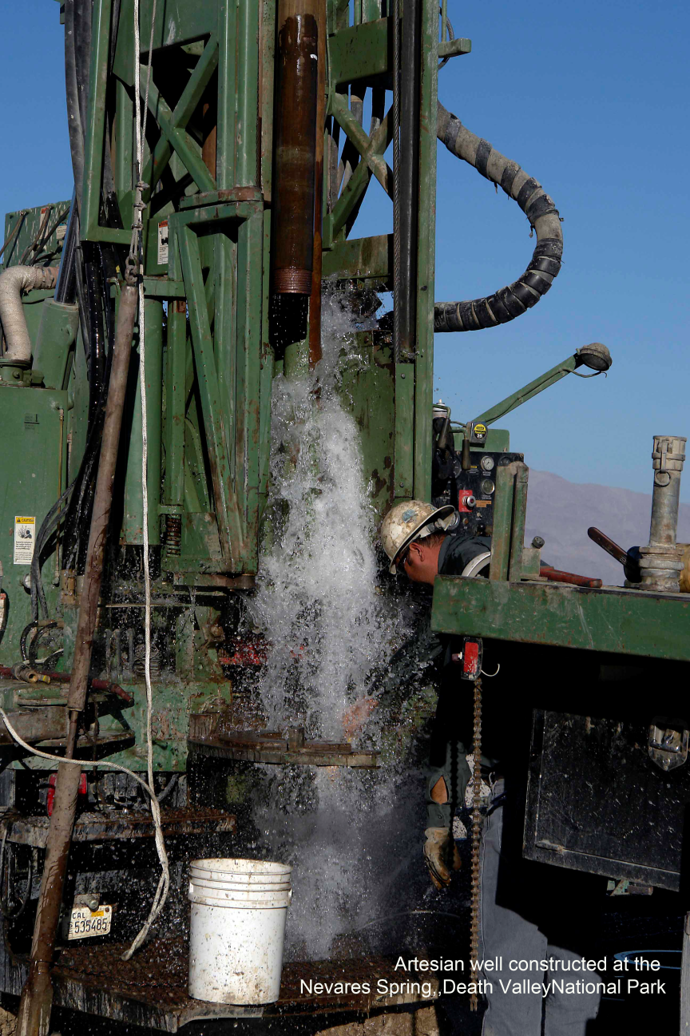
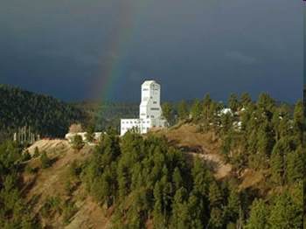

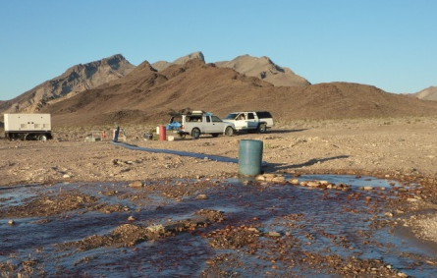
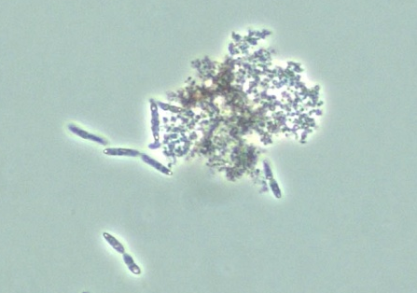
HS-4850B-04G (5)
AY741704 Unc. clone TTMF164 (SA gold mine)
NSDW2 09C
NSDW2 04E (3)
NSDW2 12E
HS-4850B-09D
NSDW2 05G
NSDW2 11B (3)
NSDW2 12F
BLM-1 01G (7)
AB232785 Pelotomaculum isophthalicicum
ALMENDRO 09H
AY884087 Moorella thermoacetica
BLM-1 02E
ALEMAN 03A
U12N.10B 03A
GASCON 01B (5)
AB436739 Desulfonosporus sp. AAN04
NASH 10G
U12N.10B 03H
BLM-1 11A
BLM-1 01F
Y11574 Desulfotomaculum thermobenzoicum
BLM-1 07A
U12N.10V 09D (2)
U12N.10B 04B (5)
AY604055 Unc. clone DR9IPCB16SCT8 (SA gold mine)
FJ712408 Unc KZNMV-0-B13 (Kazan Mud Volcano)
U12N.10V 03D
AM777970 Unc. clone CVCloAm2Ph32 (Portugal GW)
AY741695 Unc. clone TTMF21 (SA mine)
DQ088771 Unc. clone BE325FW032701CTS (SA mine)
NC_010424 Candidatus Desulforudis audaxviator MP104C
ER-EC-11 07D
AY753389 Unc. clone SK21 (alkaline district heating system biofilm)
NC_011296 Thermodesulfovibrio yellowstonii
AJ309733 Aquifex aeolicus
0.02
Cleared figure, NNSA

Slide 23
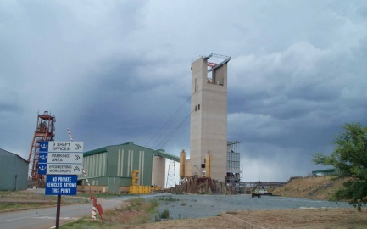
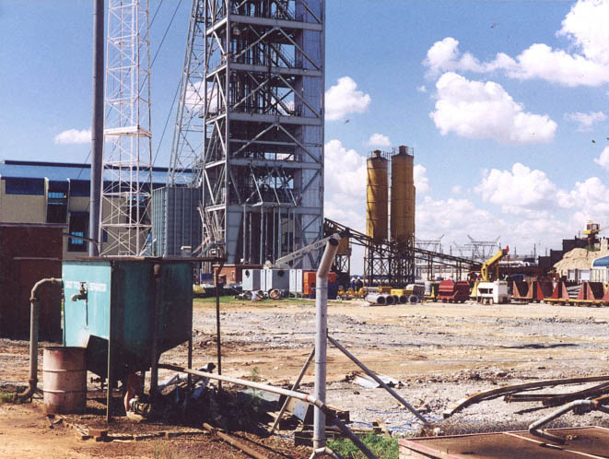
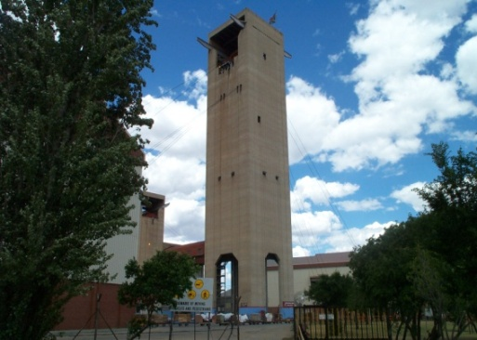
HS-4850B-04G (5)
AY741704 Unc. clone TTMF164 (SA gold mine)
NSDW2 09C
NSDW2 04E (3)
NSDW2 12E
HS-4850B-09D
NSDW2 05G
NSDW2 11B (3)
NSDW2 12F
BLM-1 01G (7)
AB232785 Pelotomaculum isophthalicicum
ALMENDRO 09H
AY884087 Moorella thermoacetica
BLM-1 02E
ALEMAN 03A
U12N.10B 03A
GASCON 01B (5)
AB436739 Desulfonosporus sp. AAN04
NASH 10G
U12N.10B 03H
BLM-1 11A
BLM-1 01F
Y11574 Desulfotomaculum thermobenzoicum
BLM-1 07A
U12N.10V 09D (2)
U12N.10B 04B (5)
AY604055 Unc. clone DR9IPCB16SCT8 (SA gold mine)
FJ712408 Unc KZNMV-0-B13 (Kazan Mud Volcano)
U12N.10V 03D
AM777970 Unc. clone CVCloAm2Ph32 (Portugal GW)
AY741695 Unc. clone TTMF21 (SA mine)
DQ088771 Unc. clone BE325FW032701CTS (SA mine)
NC_010424 Candidatus Desulforudis audaxviator MP104C
ER-EC-11 07D
AY753389 Unc. clone SK21 (alkaline district heating system biofilm)
NC_011296 Thermodesulfovibrio yellowstonii
AJ309733 Aquifex aeolicus
0.02
Cleared figure, NNSA

Slide 24
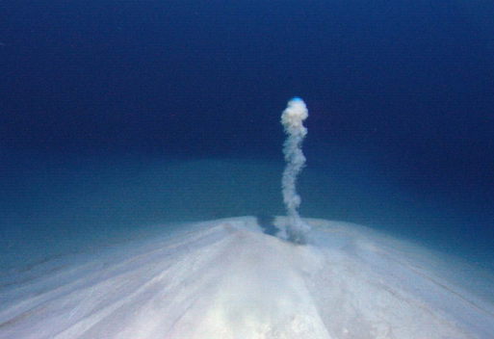
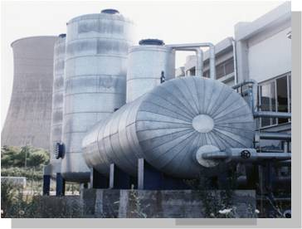
HS-4850B-04G (5)
AY741704 Unc. clone TTMF164 (SA gold mine)
NSDW2 09C
NSDW2 04E (3)
NSDW2 12E
HS-4850B-09D
NSDW2 05G
NSDW2 11B (3)
NSDW2 12F
BLM-1 01G (7)
AB232785 Pelotomaculum isophthalicicum
ALMENDRO 09H
AY884087 Moorella thermoacetica
BLM-1 02E
ALEMAN 03A
U12N.10B 03A
GASCON 01B (5)
AB436739 Desulfonosporus sp. AAN04
NASH 10G
U12N.10B 03H
BLM-1 11A
BLM-1 01F
Y11574 Desulfotomaculum thermobenzoicum
BLM-1 07A
U12N.10V 09D (2)
U12N.10B 04B (5)
AY604055 Unc. clone DR9IPCB16SCT8 (SA gold mine)
FJ712408 Unc KZNMV-0-B13 (Kazan Mud Volcano)
U12N.10V 03D
AM777970 Unc. clone CVCloAm2Ph32 (Portugal GW)
AY741695 Unc. clone TTMF21 (SA mine)
DQ088771 Unc. clone BE325FW032701CTS (SA mine)
NC_010424 Candidatus Desulforudis audaxviator MP104C
ER-EC-11 07D
AY753389 Unc. clone SK21 (alkaline district heating system biofilm)
NC_011296 Thermodesulfovibrio yellowstonii
AJ309733 Aquifex aeolicus
0.02
Cleared figure, NNSA

Slide 25
HS-4850B-04G (5)
AY741704 Unc. clone TTMF164 (SA gold mine)
NSDW2 09C
NSDW2 04E (3)
NSDW2 12E
HS-4850B-09D
NSDW2 05G
NSDW2 11B (3)
NSDW2 12F
BLM-1 01G (7)
AB232785 Pelotomaculum isophthalicicum
ALMENDRO 09H
AY884087 Moorella thermoacetica
BLM-1 02E
ALEMAN 03A
U12N.10B 03A
GASCON 01B (5)
AB436739 Desulfonosporus sp. AAN04
NASH 10G
U12N.10B 03H
BLM-1 11A
BLM-1 01F
Y11574 Desulfotomaculum thermobenzoicum
BLM-1 07A
U12N.10V 09D (2)
U12N.10B 04B (5)
AY604055 Unc. clone DR9IPCB16SCT8 (SA gold mine)
FJ712408 Unc KZNMV-0-B13 (Kazan Mud Volcano)
U12N.10V 03D
AM777970 Unc. clone CVCloAm2Ph32 (Portugal GW)
AY741695 Unc. clone TTMF21 (SA mine)
DQ088771 Unc. clone BE325FW032701CTS (SA mine)
NC_010424 Candidatus Desulforudis audaxviator MP104C
ER-EC-11 07D
AY753389 Unc. clone SK21 (alkaline district heating system biofilm)
NC_011296 Thermodesulfovibrio yellowstonii
AJ309733 Aquifex aeolicus
0.02
Cleared figure, NNSA

Slide 26
What’s Next?
Expand culture collection (Desulforudis americanus)
Single cell genomics (Desulforudis americanus)
More chemistry and radiochemical modeling
Deep sequencing project (DCO/Alfred P. Sloan FDN.)
Uranium microcosm
Microbial dissolution of NNSS melt glass exp.
10 Micron
Sulfate reducing bacterium from BLM1

Slide 27
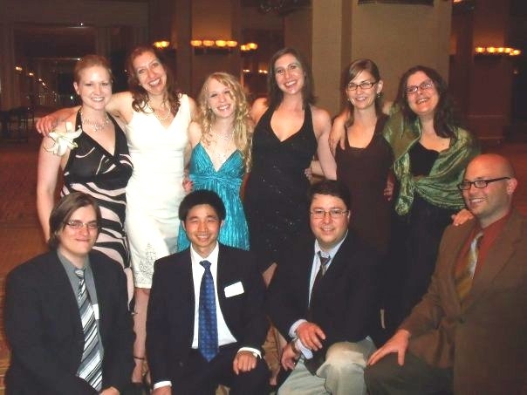
Postdocs
Jim Bruckner (JPL)
Jen Fisher (UGA)
Gaosen Zhang (CAS)
Grad Students
Susanna Blunt
*Stephanie Labahn
Undergraduates
*Mary Ehrsam
*Juan Plata
*Jessica Newburn
Patty Edmiston
Summer students
Christina Jocovides
Alex Michaud
Chelsey VanDrisse
High School
Alexandra Wheatley
Joseph knue
Chance Creigh
Visiting Scientists
Michael Leonardo
The People Who Make it Happen
*Recent graduates

Slide 28
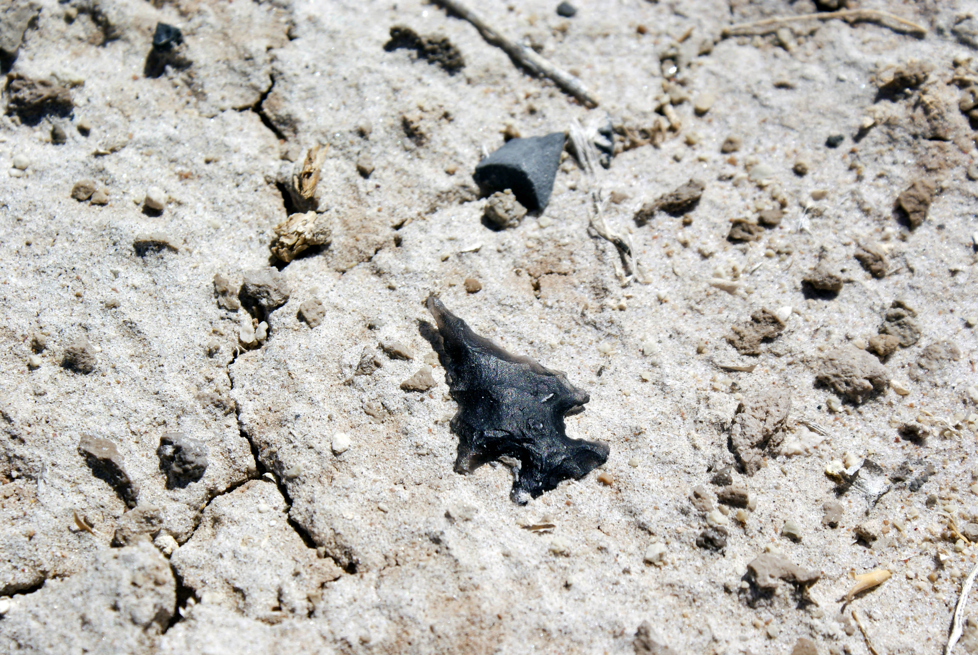
Acknowledgements
Special thanks to Bill Wilborn for enabling site access at UGTA wells. Thanks to Russell Sheldon, Jeff Wutz, Jeff Sanchez, Robert Goodwin and many others who have worked with us at the NNSS. Thanks also to Mike Bower, Terry Fisk, Kevin Wilson, Richard Friese, David Ek, Linda Manning and others from the NPS for assistance and guidance that enabled sampling at Nevares deep well and Devils Hole. Thanks to Michael King and Walter Slack for funding and sampling assistance at Nevares. Thanks to Levi Kryder, Roger McRae, Bill Howard, Jamie Walker and the rest of the team at Nye County for funding and deep well sampling opportunities, and many others who have followed this unusual project for several years. This work has been funded primarily by DOE ERSP, DOE SBR, DOE EPSCOR, the Hydrodynamics Group, LLC, the Nuclear Waste Repository Project Office, .

